Slide 1
Gesture Controlled
Robot
By: Graham Guthrie

Slide 2
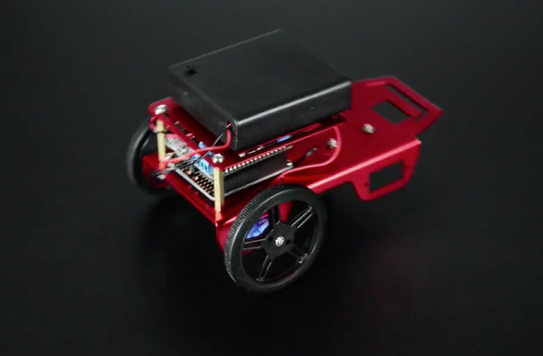
Objectives
Use wireless communication to control robot movements
Robot will move based on hand movements
May add laser or camera for added functionality
Potential Applications:
Wheelchair Control
Unmanned Vehicle Control

Slide 3
Design
Three main components:
Robot Chassis
Servo Motors
Microcontroller
Transceiver
Glove
Accelerometer
Transceiver
Switch
Pan Tilt
Mounted on chassis
Controlled by glove after switching
Potential camera attachment

Slide 4
Components and Budget
2 - NRF24L01 Transceivers ($5.95)
2 - Micro Servo Motors ($15)
Robot Chassis (FREE)
Pan-Tilt Kit with Servo Motors ($18.95)
Sunfounder Mega ($15)
Arduino Uno (Free)
Glove (?)
Flex Sensor ($7.95)
Accelerometer ADXL335 ($14.95)
2- LEDs (Free)
Tentative Budget Total:
$77.80

Slide 5
Resources
http://howtomechatronics.com/tutorials/arduino/arduino-wireless-communication-nrf24l01-tutorial/
http://www.instructables.com/id/ROBOTIC-ARM-Arduino-Controlled/
https://circuitdigest.com/microcontroller-projects/diy-arduino-robotic-arm-tutorial
https://diyhacking.com/remote-control-car/
https://diyhacking.com/hand-gesture-controlled-robotic-arm-arduino/
https://create.arduino.cc/projecthub/user206876468/hand-gesture-controlled-robot-4d7587
https://www.sparkfun.com/tutorials/348
http://www.instructables.com/id/RC-Control-and-Arduino-A-Complete-Works/

